Slide 1






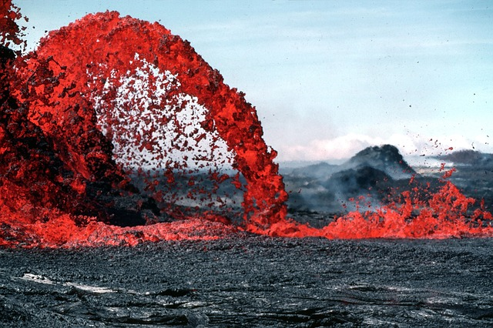

SAMPLE
Earth’s Structure
PowerPoint

Slide 2
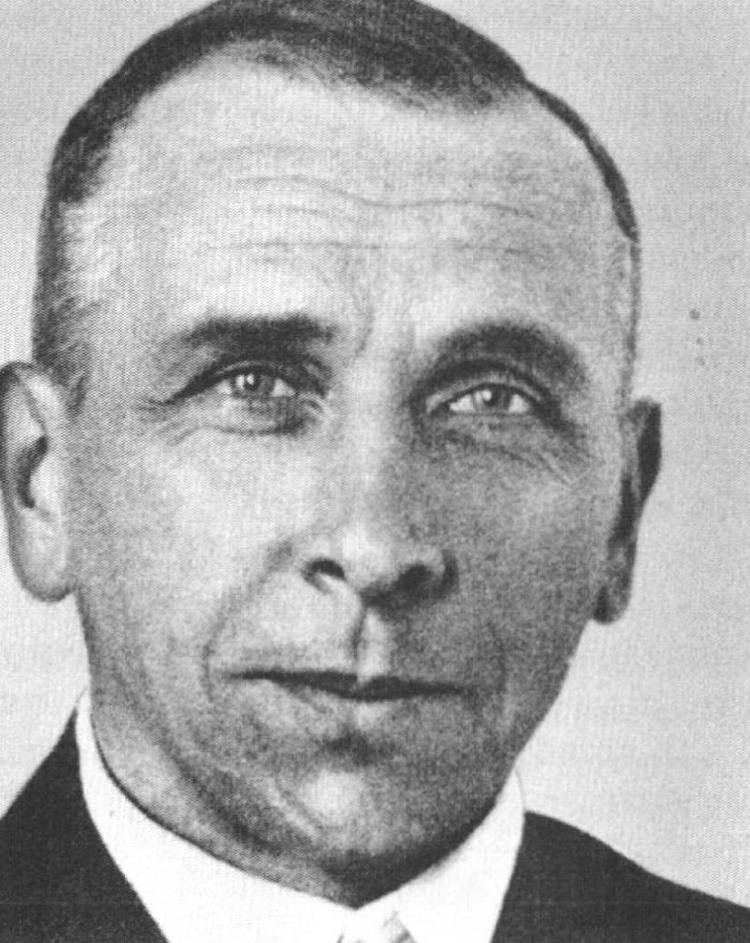
Continental Drift
In 1915, Alfred Wegener, a German meteorologist and geologist suggested that the continents were moving slowly across the Earth’s surface. This theory became known as the Theory of Continental Drift.
Notes:
Continental Drift song from Ice Age!

Slide 3
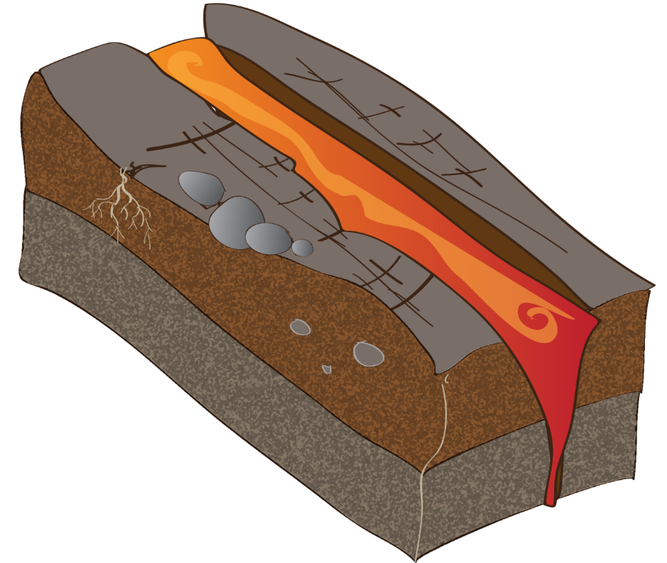
Continental Drift
At the time Wegener could not explain how the continents moved through the sea floor. His theory was rejected until 1950 when scientists discovered molten rock from the mantle spewing up in the ocean basins.
Notes:
Continental Drift song from Ice Age!

Slide 4
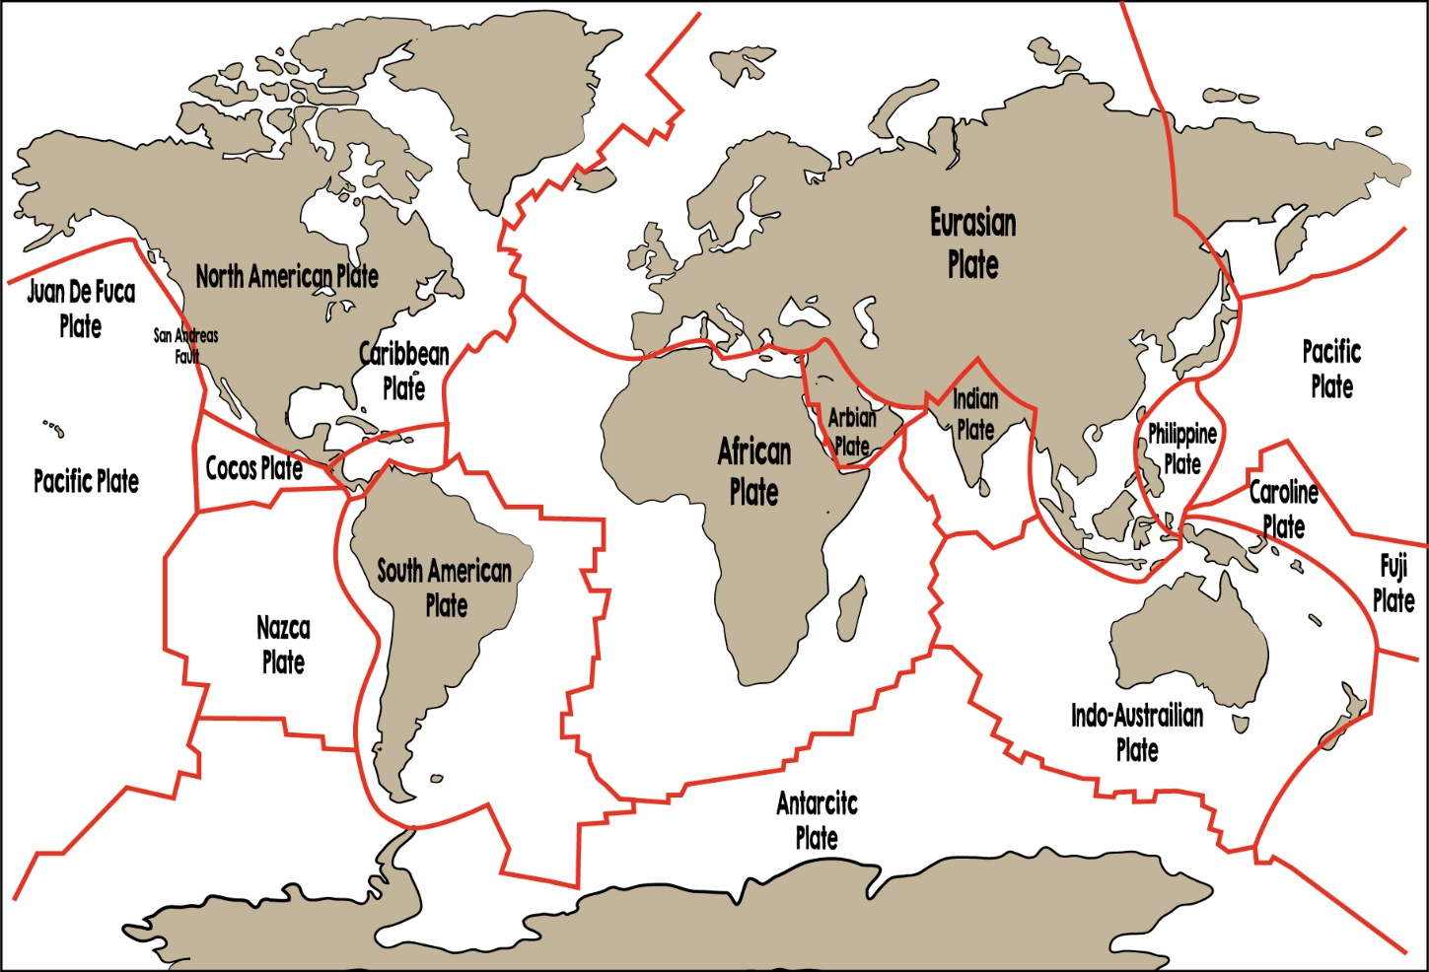
Continental Drift
This discovery showed scientists that the lithosphere is not a solid shell, but is broken into giant pieces called tectonic plates.
Notes:
Continental Drift song from Ice Age!

